Slide 1
Practical Xamarin
Danny Warren
dannydwarren@gmail.com
@dannydwarren (Twitter, LinkedIn)

Slide 2

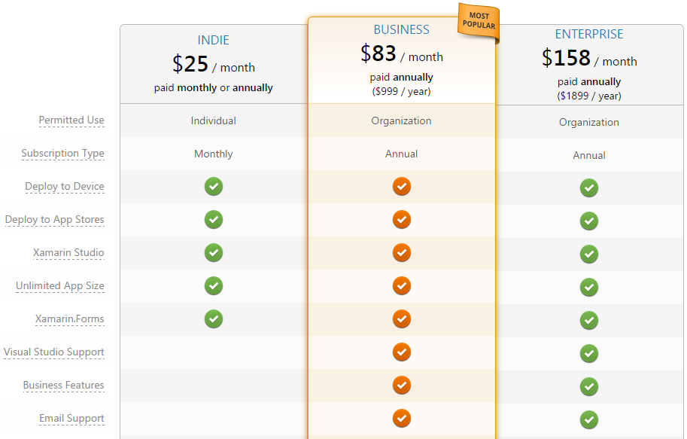
What is Xamarin?
Cross-Platform Mobile App Framework
Built on Mono
Code = C#
UI = Native to Platform
Code-behind = C#
Allows Developers to Learn New Platforms Not New Languages
Visual Studio Integration
Only for Business and Enterprise

Slide 3
Benefits of Using Xamarin
Shared App Business Logic
Write Once, Run Everywhere
Unit Tests of Business Logic cover all platforms
Portable Code to Web, IoT, Windows and Mac Desktop Applications
Faster Development/Testing Cycles
Native Look and Feel to Each Platform
Learn C# + 3 UI Frameworks
Instead of 3 Languages AND 3 UI Frameworks
Xamarin also has other helpful solutions like:
Xamarin Test Cloud
Xamarin Insights

Slide 4
What do I need?
Android
iOS
Xamarin License for Android
Windows or Mac OS
Xamarin Studio
Android Device(s) [phone/tablet]
For Testing
Learn Android Framework
Camera, GPS, etc.
Learn AXML UI Definition Language
Similar to XAML
Xamarin License for iOS
Mac OS
For Building App Package
Xamarin Studio
Xcode
iOS Device(s) [phone/tablet]
For Testing
Learn iOS Framework
Camera, GPS, etc.
Learn Cocoa Touch
Like nothing you’ve ever seen!

Slide 5
What do I need?
Windows
Getting Started Guide
No Xamarin License
Windows
Visual Studio Community Edition
Windows Device(s) [phone/tablet]
For Testing
Learn WinRT Framework
Camera, GPS, etc.
Learn XAML UI Definition Language
http://developer.xamarin.com/guides/ios/getting_started/installation/windows/?utm_source=visualstudio&utm_medium=referral&utm_content=ios-gettingstarted&utm_campaign=vs

Slide 6
Where/How do I get a Mac?

Slide 7

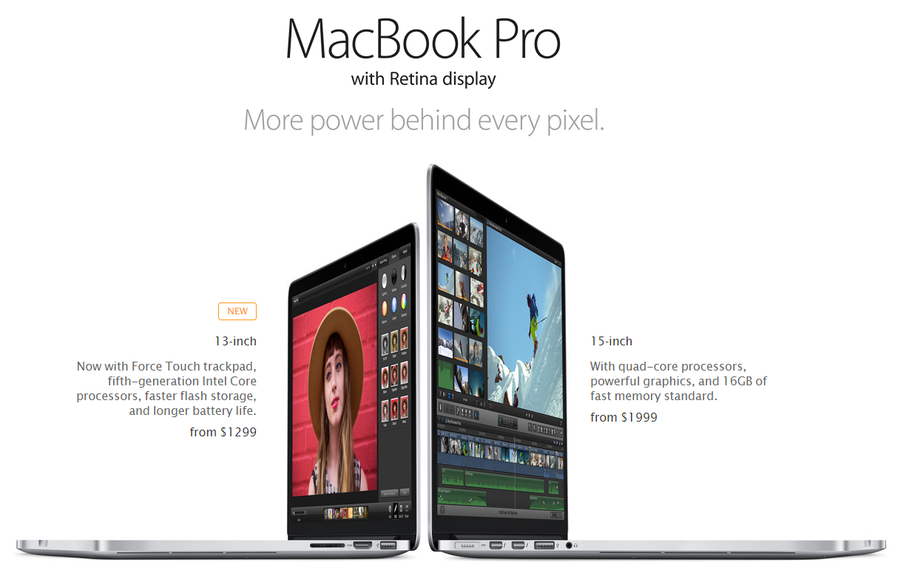
Apple
http://www.apple.com/mac-mini
http://www.apple.com/macbook-pro

Slide 8
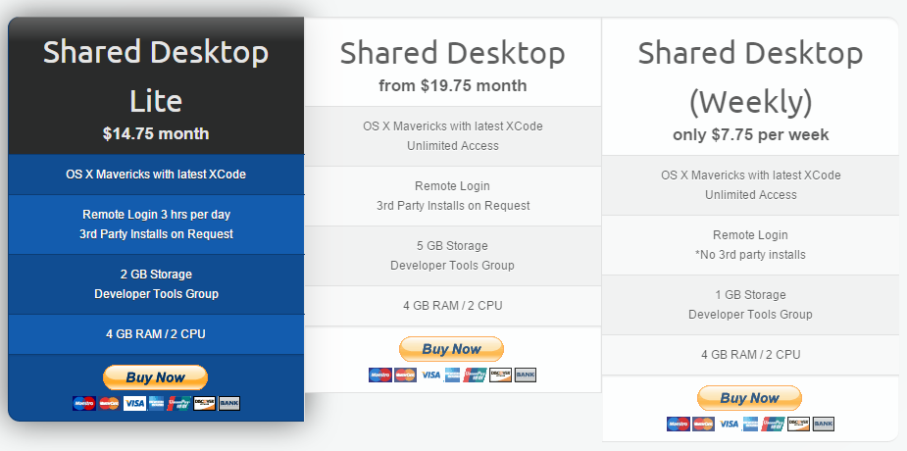

vmOSX
http://virtualmacosx.com

Slide 9


Xcode Server Hosting
http://xcodeserverhosting.com

Slide 10

macincloud
http://www.macincloud.com

Slide 11
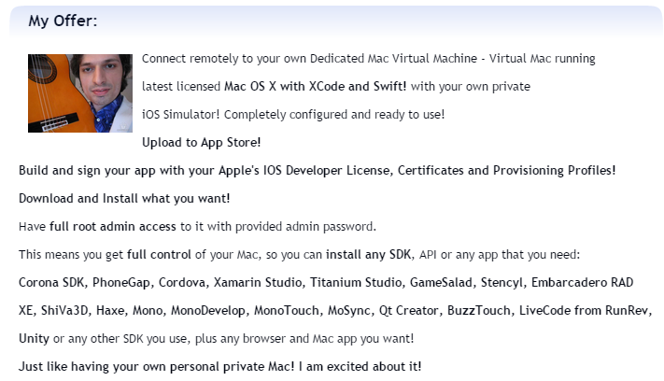

XCodeClub
http://xcodeclub.com

Slide 12
Mac Build Server Options

Slide 13


hostedci
https://hosted-ci.com
*Will not work if you can’t install Xamarin

Slide 14
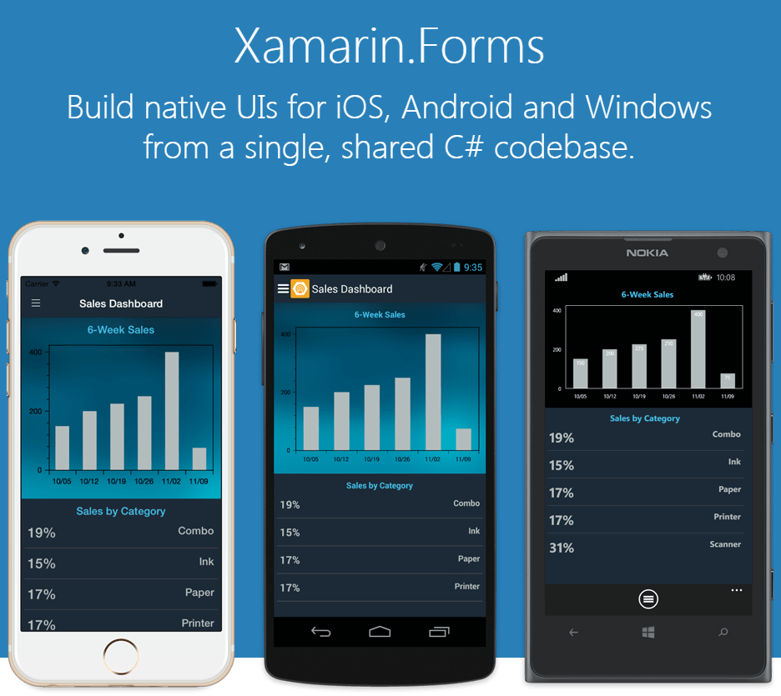
What is Xamarin.Forms?
Instead of Writing the UI for Each Platform, Only Write 1 UI
Wraps Native Controls in an Abstraction of Xamarin.Forms Controls
Theoretically Maintains Native Look, Feel, and Performance
Can be Mixed With Native UI Controls for Extreme Flexibility

Slide 15
My Experience
Theory | Reality
UI Fits Each Platform Native Look and Feel | The App Looks the Same on Each Platform with minor styling differences
Performance Would Not be Compromised | Performance was Severely Compromised
Write Once Run Everywhere Each Platform Performs the Same | Write Once, Tailor Everywhere Each Platform Performed Differently
Very Little Native UI Code Required Very Few UI Renderers | Everything That Wasn’t a Simple UI Control Required Native Code LOTS of UI Renderers *We Had to Learn the Native UI Framework Anyway
Take Less Time to Write Than 3 Native UIs (For First Write) | Jury is Still Out on Time Due to All the Issues We Encountered

Slide 16
My Experience
Theory | Reality
XAML is the Way to Write Your UI | XAML is Not Compiled and Therefore Impacts Performance XAML Compilation is Coming Soon http://forums.xamarin.com/discussion/38729/xamarin-forms-1-4-3-pre2-released
Xamarin.Forms IS THE Way to Write Mobile Apps | True Native IS THE Way to Write Mobile Apps Unless You Don’t Do Lists, Videos, Support App Lifecycle, and Aren’t Written in XAML (yet)

Slide 17
Red Flags: Don’t Use Xamarin.Forms
Video
Image Buttons
Lots of Images
Long Lists
Complicated List Items
Lots of Labels
Almost all apps!
Mostly an Android Issue
You Already Known Android and/or iOS and/or Windows Native UI Frameworks

Slide 18
So is Xamarin Worth It?

Slide 19

*Just not Xamarin.Forms (at least not for now)

